Slide 1
8th European Workshop on Microelectronics Education, Darmstadt, 10.5.2010
Challenges in the Development of Mobile Phones
Dr. Christoph Kutter
Corporate VP, R&D Excellence
Infineon Technologies AG
Notes:
Date:
Tue, 2010-03-09
Time:
07:30 - 08:30
Location / Room:
Grosser Saal, Hall Level
Session Chair:
G De Micheli, EPF Lausanne, CH
0830 OPENING REMARKS AND AWARDS
G De Micheli, General Chair, EPF Lausanne, CH
W Mueller, Programme Chair, Paderborn U / C-LAB, DE
Presentation of Distinguished Awards by Z Peng, Linkoping U, SE
Welcoming addresses by:
Dirk Hilbert, Deputy Mayor, Head of Department of Economic Affairs, Dresden
Hansjoerg Koenig, State Secretary, Saxon State Ministry for Higher Education, Research and the Fine Arts
KEYNOTE ADDRESSES
0910 ALL THINGS ARE CONNECTED
Alberto Sangiovanni-Vincentelli, UC Berkeley and Cadence, US
Abstract: Design of complex system is essentially about connections: Connection of concepts, Connection of objects, Connection of teams. And products of the future will be connected seamlessly across physical and virtual domains. Connections can produce systems that offer more than the sum of the components but they can also yield to systems that are less powerful than the sum of the components or that are so compromised by their interactions that they do not work at all.
Collaboration is the name of the game for design, for production, for operation of multi-scale systems.
There is increasingly less distance between design and operation of systems. An efficient management of interactions among deployed parts of a larger system requires principles that are common to the design methods developed at the bleeding edge of technology. I will examine the evolution of design principles and of multiscale systems and the challenges we are facing today. I will point to a number of exciting fields where advances are constantly made towards the mastering of connections.
0950 WIRELESS COMMUNICATION – SUCCESSFUL DIFFERENTIATION ON STANDARD TECHNOLOGY BY INNOVATION
Herman Eul, VP, Infineon and University of Hannover, DE
Abstract: The rise of the wireless internet is the megatrend in communication industry. Mobile communication devices will be the dominant platform for information access, gaming, music and spending time with distant friends. About 5 bn or three quarters of the world population is using mobile phones. Internet enabled mobile phones at affordable cost will be the most common internet access device in the near future. At the high end powerful and versatile smartphones need faster and more energy efficient semiconductors.
The presentation will start with a brief summary of the paradigm shifts in the “mobile world” from voice calls to data transmission and the current situation in the renascent mobile ecosystem. The entry of powerful internet and consumer brands and now even luxury designer brands into the mobile handset arena mark the start of a new era changing the dynamics in this field.
Today, fabless or fab-lite business models are common in the wireless semiconductor value chain. In this model vendors differentiate through services, architectures, design but also their capability to extract maximum product benefits in density, power consumption, performance, functionality and robustness/yield from a standard CMOS process. In the highly competitive mobile phone market growth and profit depends on differentiation by innovation. This requires technology know-how being effectively transferred into the design system and application specific device structures to create optimised circuits.

Slide 2
Content
Mobile Phone Market
Thrills and Challenges
Success Example: Egoldvoice – Winner of the Innovation Award
Infineon at a Glance

Slide 3
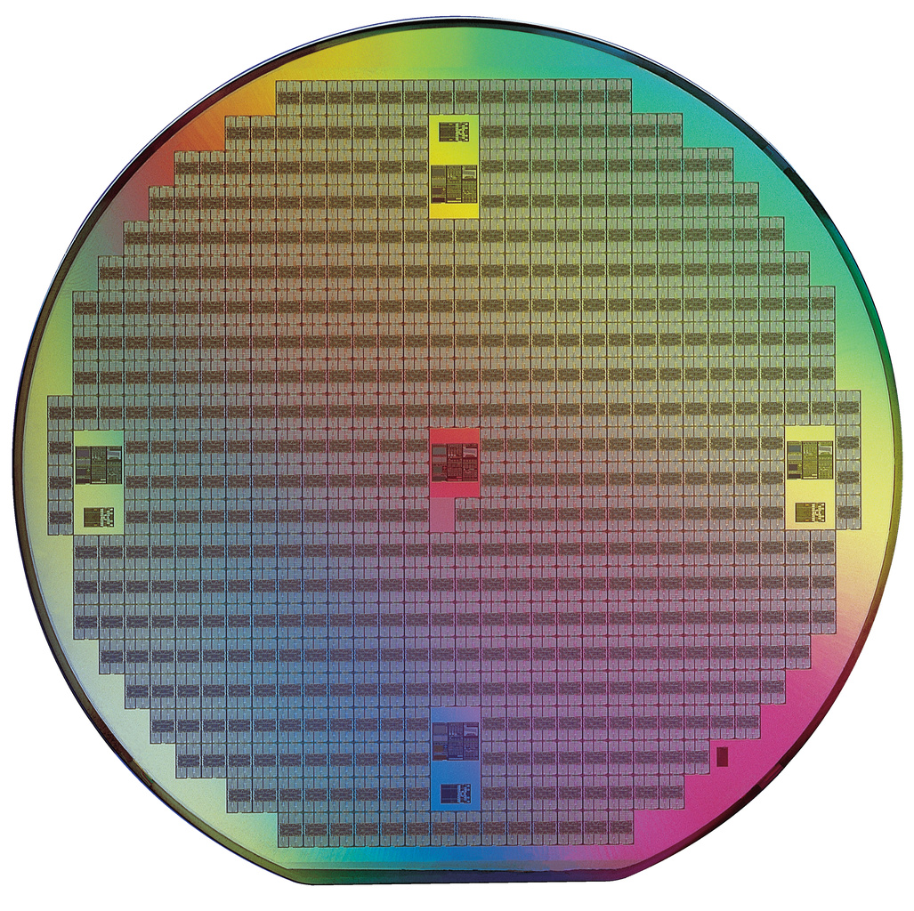
Semiconductor market
Source: WSTS, iSupply, Gartner, VLSI, IC Insights, Future Horizons, Infineon

Slide 4
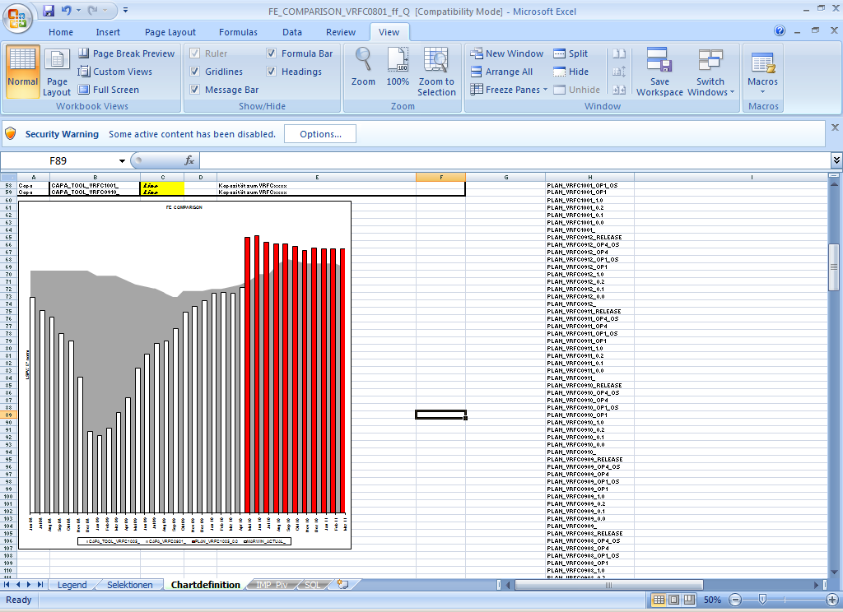
Situation in Production
Jan 2009
April 2010
capacity
Auslastung Nachfrage
Anmerkung: Layer Starts 8", Bsp. Frontend Power
Fast Switch from Idle to Allocation Situation
Anmerkung: Graphik zeigt Kapazitätsentwicklung der vergangenen Monate.
Notes:
Alle Divisions sind von Allokation betroffen.
Sehr herausfordernde Situation für Infineon. Trotzdem ist sie besser als die Krisensituation im letzten Jahr. Details:
Auslastung vorhandener Kapazität ist erreicht.
Nachfrage übertrifft Kapazität bei weitem.
Grafik zeigt die Auslastungssituation bei Fronend Power (FEP), aber vergleichbare Situation auch bei Frontend CMOS (FEC) und Auftragsfertigern.
Die Grafik zeigt: Frontend Power (FEP), inhouse Production, Layer starts per week (LSPW) 8”:
Weiss: Aktuelle Auslastung Juni 2008 bis April 2010
Rot: Produktionsnachfrage Mai 2010 bis März 2011
Grau: Fertigungskapazität
Januar 2009: 183 k LSPW / April 2010: 532k LSPW

Slide 5
Unit Shipments of Selected Applications [2009E]
Million
units
Mobile Phones
MP3 Player
Notbooks
Digital Set Top Boxes
PCs
DVD Player/
Recorder
Digital
Cameras
Video
Games

Slide 6
New Platform Development and Efforts
Year 1
Year 2
Year 3
Year 4
HW Components
Platform
SW Components
Lead Customer Project
typ. 12 months
2nd Customer Project
typ. 6 months

Slide 7
Content
Mobile Phone Market
Thrills and Challenges
Success Example: Egoldvoice – Winner of the Innovation Award
Infineon at a Glance

Slide 8


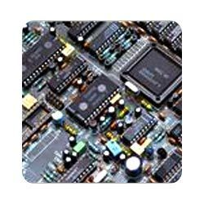

System on Chip Thrills and Challenges
Performance
Low Power
Integration
Cost

Slide 9
Performance Need
Peak Rate (Time)
GPRS
80 kbps (500s)
2G
EDGE
238 kbps (168s)
3G
UMTS
384 kbps (104s)
HSDPA
7.2 Mbps (5.6s)
150 Mbps (0.3s)
4G
LTE
0.0
0.5
1.0
1.5
2.0
2.5
3.0
3.5
4.0
4.5
5.0
Data Downloaded (Mega-Bytes)
SMS
Email
Java Games
Video
VDSL2
50 Mbps (0.8s)

Slide 10
Performance Need: Inner Receiver
Inner Receiver Complexity Doubles Every 2.5 Years

Slide 11

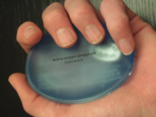
Power Consumption:
What do you want to do with your Mobile Phone?
X
Communicate
Warming your Hands

Slide 12
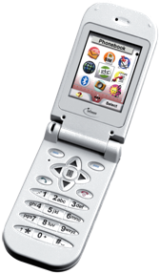
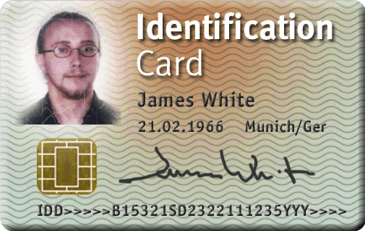
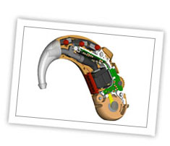


Typical Low Power Applications
… and their current consumption
GSM
Active ~ 200 mA
Standby ~ 1 – 2 mA
Contactless Controller
~ 2 – 10mA
Hearing Aid
~ 1 mA
RFID transponder
~ 20µA – 100µA
Quartz Clock
~ 250nA

Slide 13
Power Consumption Basics
P = P_{dynamisch} + P_{statisch}
P_{dynamisch} = α C_{L} f V_{dd}²
P_{statisch} = ∑ I_{leak} V_{dd}
130 nm
90 nm
65 nm

Slide 14
Real Life example of Leakage current improvement
180nm
Factor 6.3x
130nm
Factor 25x
90nm

Slide 15
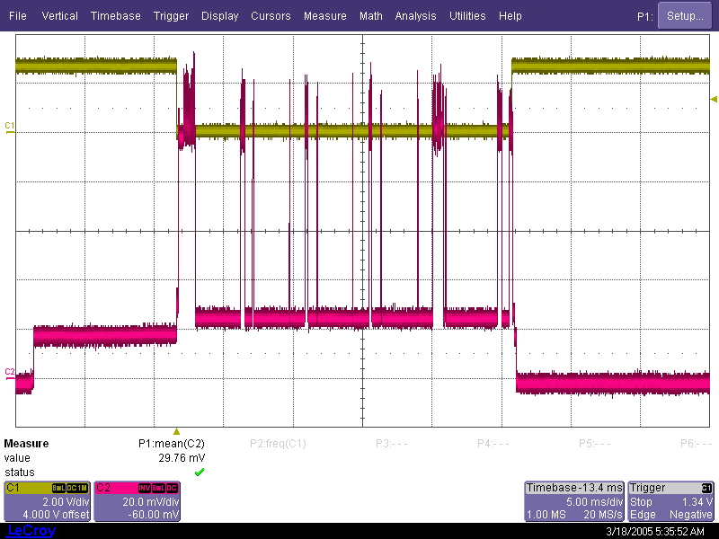
Mobile Phone in Stand-by Modus
Active until ...
SW puts system in idle mode
SW puts system in normal mode
ARM leaves
WFI state
ARM enters
WFI state
HW pre-wakeup
trigger active
SW puts system in deep sleep
Current consumed
by baseband domain
Paging Mode plus Additional Actions
Battery measurement
Location update
Neighbor cell monitoring
Temperature mgt
Display update

Slide 16
System on Chip Thrills and Challenges
Performance
Low Power
Integration
Cost
Technology Scaling
Low Power Techniques: Freq./Volt. Scaling, Power switches, …
SOC Integration of Digital, Analoge, RF
Integration of External Elements, e.g. Capacitor

Slide 17

Skaling Theory
L_{gate} / α
L_{gate}
Source
Drain
Source
Drain
Skaling Factor α:
(Gate) Length L / α
(Wire) Width W / α
Oxid Thickness t_{ox} / α
Voltage V / α
Result:
Density ≈ α²
Speed ≈ α
Power ≈ 1/ α²
2009-09-09

Slide 18
Skaling Theory
L_{gate} / α
L_{gate}
Source
Drain
Source
Drain
Skaling Factor α:
(Gate) Length L / α
(Wire) Width W / α
Oxid Thickness t_{ox} / α
Voltage V / α
Result:
Density ≈ α²
Speed ≈ α
Power ≈ 1/ α²
2009-09-09

Slide 19
Optical Enhancement Techniques
250nm
Design
Mask
Wafer

Slide 20
Optical Enhancement Techniques
250nm
90nm
Design
Mask
Wafer
+ high NA

Slide 21
Optical Enhancement Techniques
250nm
90nm
Design
Mask
Wafer
+ high NA

Slide 22
Optical Enhancement Techniques
250nm
90nm
28nm
28nm
Design
Mask
Wafer
+ high NA
+ Immersion

Slide 23
Optical Enhancement Techniques
250nm
90nm
28nm
28nm
Design
Mask 1
Mask 2
Mask
Wafer
+ high NA
+ Immersion

Slide 24
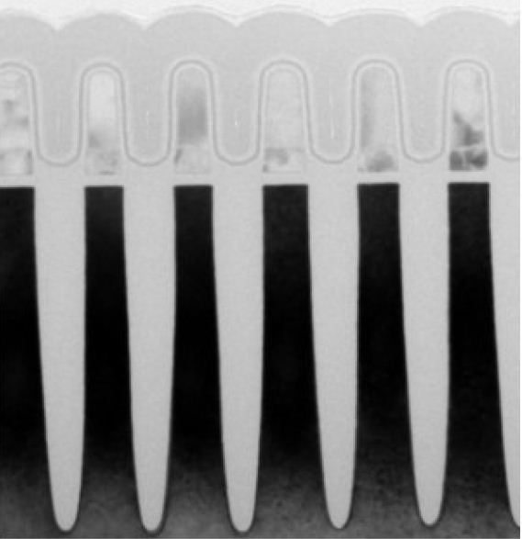
NAND Flash Technology
Gate =
Wordline
32 nm technology
Floating
Gate
Source
Isolation
Gate =
Wordline
Drain
Source: Hynix
Source

Slide 25
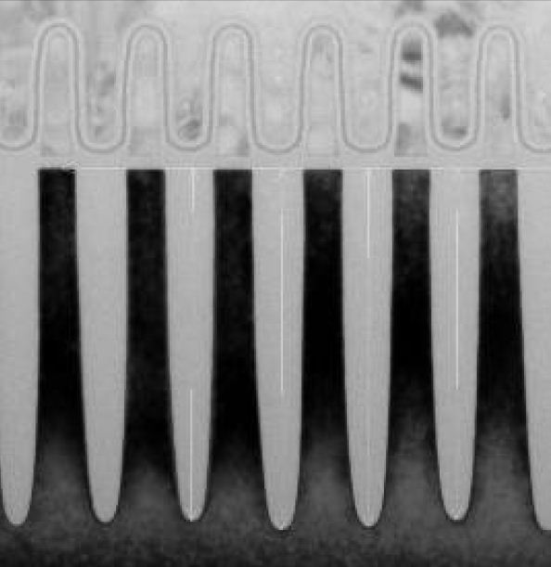
NAND Flash Technology
32 nm technology
2x nm technology
Source: Hynix

Slide 26
NAND Flash Technology
Gate
1E-3
1E-4
”1"
Floating
Gate
”0"
1E-5
1E-6
Idrain (A)
1E-7
Width
20nm
1E-8
Thickness
Tunnel-Oxide
10nm
1E-9
-2
0
2
4
6
8
10
Vcg (V)
for a V_{th} shift of 4 V:
V_{fg} = 1.3 V
Q= V_{fg} C_{TOX} = 50 electrons
Source: Hynix

Slide 27
Skaling Theory
L_{gate} / α
L_{gate}
Source
Drain
Source
Drain
Skaling Factor α:
(Gate) Length L / α
(Wire) Width W / α
Oxid Thickness t_{ox} / α
Voltage V / α
Result:
Density ≈ α²
Speed ≈ α
Power ≈ 1/ α²
2009-09-09

Slide 28
Skaling Theory
L_{gate} / α
L_{gate}
Source
Drain
Source
Drain
Skaling Factor α:
(Gate) Length L / α
(Wire) Width W / α
Oxid Thickness t_{ox} / α
Voltage V / α
Result:
Density ≈ α²
Speed ≈ α
Power ≈ 1/ α²
I_off ?
2009-09-09

Slide 29
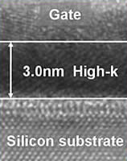
Skaling Theory
Gate
Thickness
Gate-Oxide
Source
Drain
Gate-Leckstrom
I _{Gate}
_{Leakage}
SiO2: k=3.9
HfO2: k=25
Oxid-
Dicke
4nm
3nm
2nm
1nm
2009-09-09

Slide 30
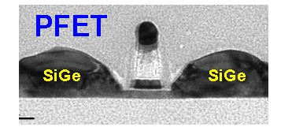
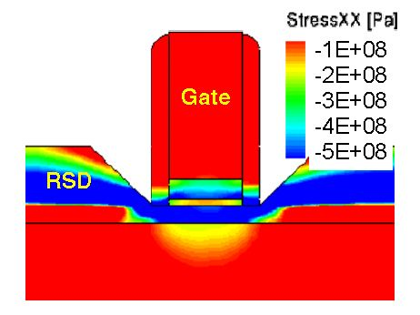
Neue Architekturen: Fully Depleted FET on SOI
Oxid
Si-Kanal: ca. 7nm
IBM, IEDM 2009
Potential Solution for 22nm node

Slide 31
Content
Mobile Phone Market
Thrills and Challenges
Success Example: Egoldvoice – Winner of the Innovation Award
Infineon at a Glance

Slide 32

The Economist, March2005

Slide 33
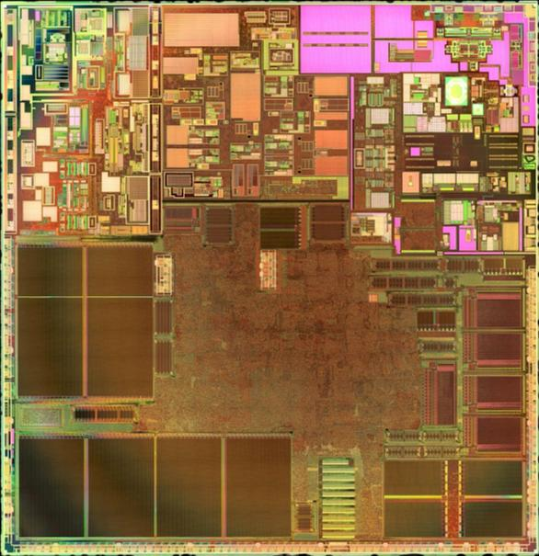
Mixed
Signal
Audio
Power
Hoch-
frequenz
30% Analog
70% Digital
20 Million
Transistors
µ-Controller
Digital Signal
Processing
Memory
Memory

Slide 34
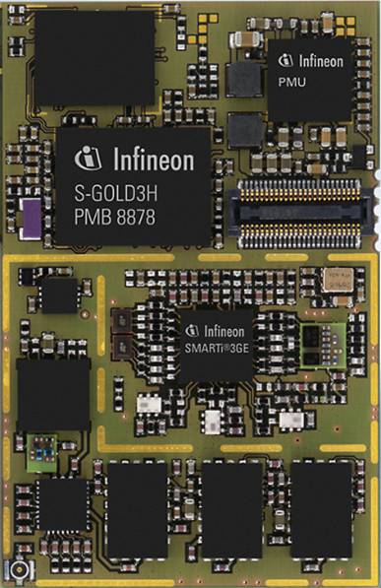
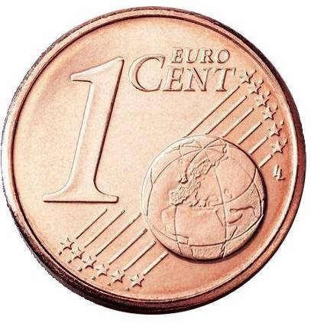
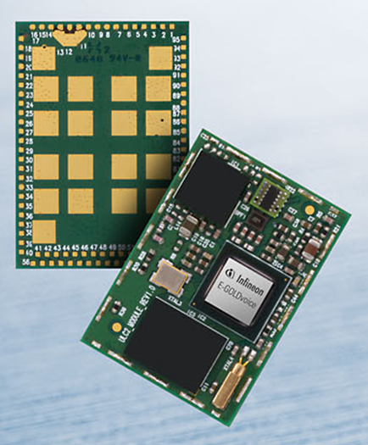
State of the Art Modem Cards:
Left: HSDPA (50x32 mm²) – Right: GPRS (17x25mm²)
Memory
PMU
Baseband
26 MHz
RF
TRX
Quad-
Band
EDGE PA
Memory
ASM
Triband WCDMA PAs
Notes:
34

Slide 35
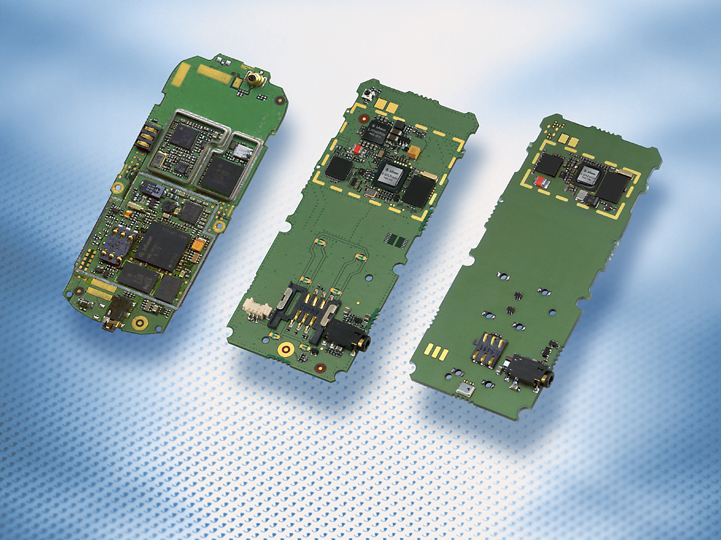
Modern Single chip solutions for mobile phones
2005
2006
2007
Mounted PCB area
Components
PCB Layers
Key Components
27 cm2 9 cm2 4 cm2
200 100 50
6 4 4
3 2 1

Slide 36
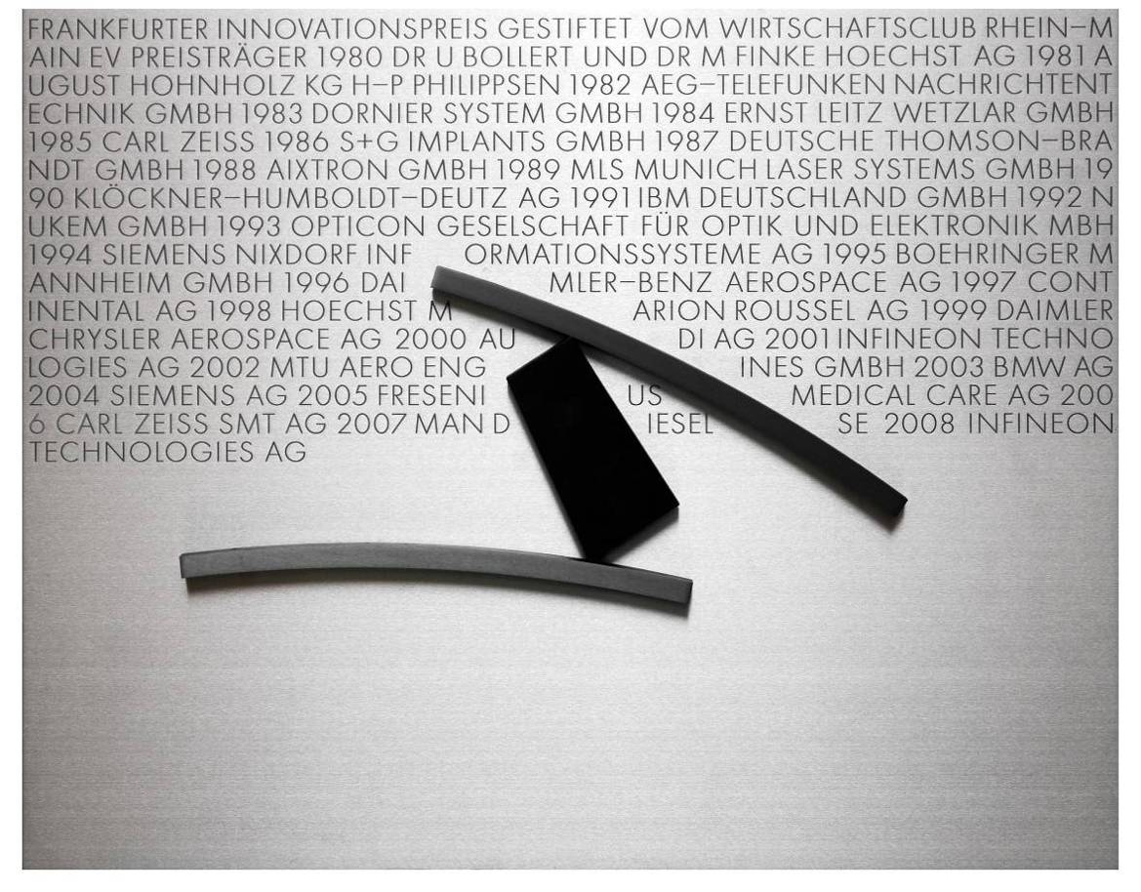
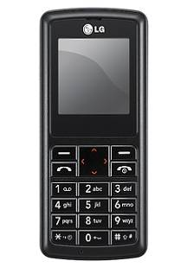
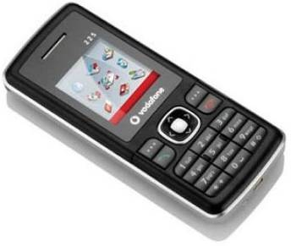
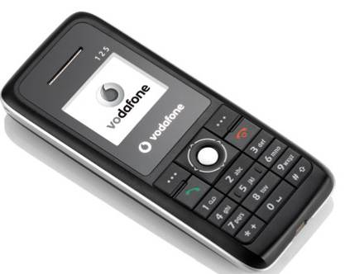

X-GOLD™101: Winner of the Innovation Award of German industry for the best technological innovation 2008
More than 180 million devices were sold so far!
Notes:
36

Slide 37
Content
Mobile Phone Market
Thrills and Challenges
Success Example: Egoldvoice – Winner of the Innovation Award
Infineon at a Glance

Slide 38
Infineon at a Glance
The Company
Infineon provides semiconductor and system solutions, focusing on three central needs of our modern society:
Energy efficiency, Communications and Security
Revenue in FY 2009: 3.027 billion EUR
Some 26,000 employees worldwide (as of Sept 2009)
Strong technology portfolio with about 22,900 patents and patent applications
More than 30 major R&D locations
Germany‘s largest semiconductor company

Slide 39






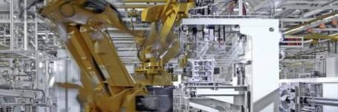

We focus on our Target Markets
Focus Areas
Energy Efficiency
Communications
Security
Core Competencies
Analog/Mixed Signal
RF
Power
Embedded Control
Our Target Markets
Automotive
Industrial Electronics
Chip Card & Security
Mobile Phone Platforms

Slide 40
Requirements on Students
Study of Electrical Engineering
High marks
Experience in Low Power Circuit Design
25 years old
10y experience in high speed, analog/mixed signal, and RF
PhD in Physics and Hablitation in Mathematics
Inventor of 20 standard relevant patents
Winner of Noble Price
Solver of the World Energy Problem
Inventor of the perpetuum mobile

Slide 41
Requirements on Students
Scientific Skills:
  Analytical Skills
  Problem Solver Skills
  Diplom, Master or PhD
  Very High Marks
Soft Skills:
  Team Player
  Language Skills
  Curiosity
  Enthusiasm
  Ready to go the extra Mile

Slide 42


