Slide 1


A Platform for VHDL Visualization
Zheng Lu, Abdulhadi Shoufan, Guido Rößling
8th European Workshop on Microelectronics Education
12.05.2010

Slide 2
outline
Introduction
  VHDL and Platform
  Motivation
VISUAL-VHDL
  a plug-in for Animal, which is a Java-based environment for algorithm visualization.
Conclusion

Slide 3
Introduction
  VHDL:
  Very-High-Speed Integrated Circuit Hardware Description Language
  Experts suppose, that in future more than 95% of the designs will be in VHDL and Verilog written.
  VHDL coding difficult to understand.
    For example:
Java | VHDL
c=a + b; | c:=a + b;
Only assign the variables. | Perhaps include: Allocation Mapping Scheduling ......

Slide 4
Introduction
Some of the existing methods:
  Project & practical training
  Seminary
  CAD
Animation platform
  Dynamic picture (Animation)
  can make abstract concept
  more concrete.
Our solution: VISUAL-VHDL
Schematic viewers in commercial synthesis programs
VISUAL-VHDL
Generated after completing
the synthesis process
Generated on the fly.
Output all at once
Interactive mode
More windows
One window
Optimization may hinder the understanding
Optimization is done on demand
Optimization is performed
in the background
Optimization can be visualized
in an auxiliary window

Slide 5
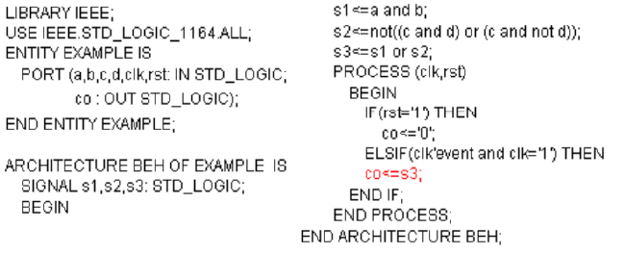
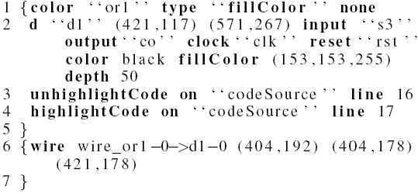
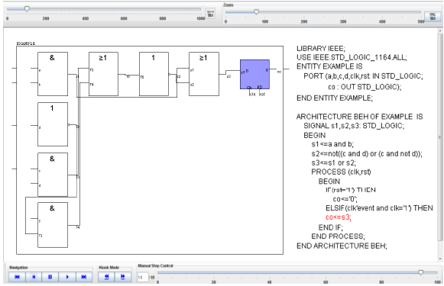
VISUAL-VHDL
VHDL Code
Code analysis and
Optimization
Generate
Extended Netlist
Primitives
Extended
Graphical Library
Effects
Extended Netlist
Generate Animations in ANIMAL
Animation

Slide 6
VISUAL-VHDL

Slide 7
VISUAL-VHDL
VHDL Code
Code Analysis and
Optimization
Generate
Extended Netlist
Primitives
Extended
Graphical Library
Effects
Extended Netlist
Generate Animations
Drag&Drop
Schematic Editor
Animation

Slide 8
VISUAL-VHDL

Slide 9
Conclusion
Conclusion
  Interactive production of circuit schematic
  Educators may
    take advantage of this tool to verify their models
    quickly generate circuit schematics using the drag & drop toolbar of the schematic editor.
Further work
  Web application
    Evaluation
  Simulation
  Other hardware description languages: Verilog….

Slide 10
Thank you!!!

Slide 11
Animal
Animal: A new interactive modeler for animations in lectures
Compact, efficient and easy to use animation tool
Graphical primitives: point, polyline, polygon, arc and text
Animation effects: display, timed display, hiding, color change, movement and rotation
AnimalScript

